Slide 1
Demo 2
CPSC 233 Group 25

Slide 2
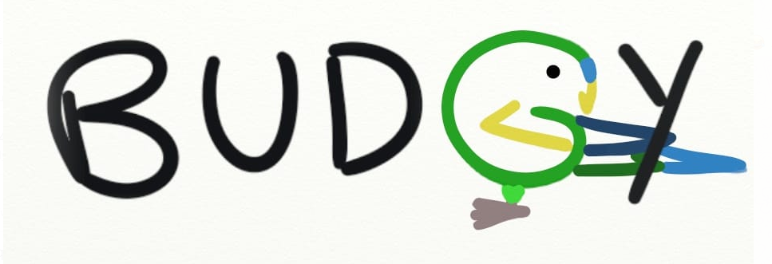

Slide 3
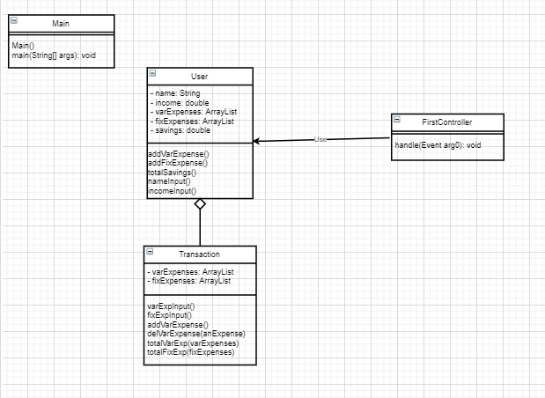
UML
Text base iteration
Prompt User for data
Preforms functions

Slide 4
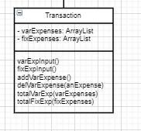
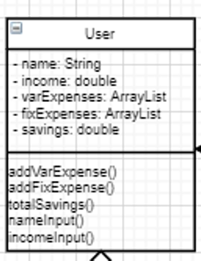
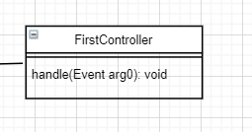
Text Based Iteration

Slide 5
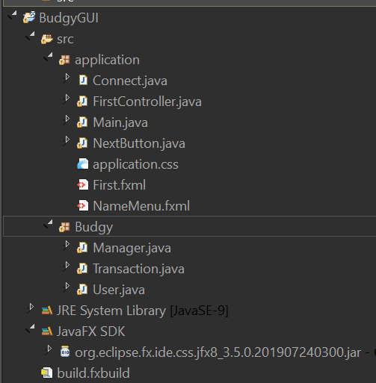
CODe Demonstration

Slide 6
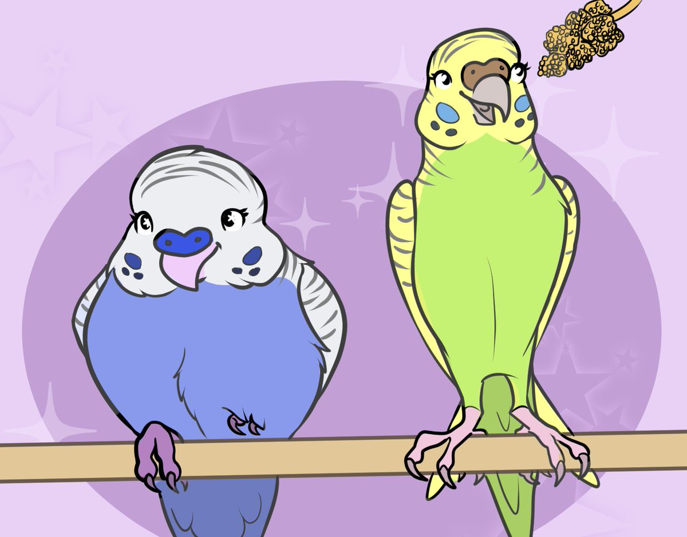
Thanks for Listening

